Slide 1
IN THE NAME OF GOD

Slide 2
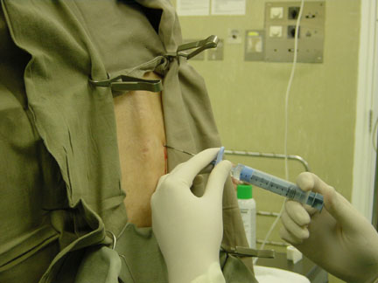
Side Effects And Complications Of Neuraxial Analgesia for labor and Delivery
Dr. Khoei
2018

Slide 3
Introduction
Neuraxial analgesia/anesthesia (ie, spinal, epidural, and combined spinal-epidural) for labor and delivery are generally very safe, but all interventions are associated with adverse effects.
Significant progress has been made in establishing the safety and efficacy of neuraxial analgesia for labor and delivery.

Slide 4
Side effects
Complications
Hypotension
Pruritus
Nausea and vomiting
Shivering
Urinary retention
Delayed gastric emptying
Inadequate analgesia
Unintentional dural puncture
Respiratory depression
Intravascular injection of local anesthetic
High neuroblockade or total spinal anesthesia
Extensive motor blockade
Prolonged neuroblockade
Sensory changes
Back pain
Pelvic floor injury

Slide 5
Side effects

Slide 6
Hypotension
Causes:
Neuraxial anesthesia/analgesia (LA)–induced sympathetic blockade
Peripheral vasodilation and venous capacitance
venous return to the heart maternal BP and COP
Intrathecal opioids Abrupt onset of pain relief maternal BP

Slide 7
……
Definition: 20% -30% drop in SBP or a SBP less than 100 mm Hg
Incidence:10% - much less after initiation of low-dose neuraxial labor analgesia
Effects: utero-placental perfusion, (severe and prolonged hypotension develop in the fetal hypoxia and acidosis).
Prevention: avoidance of aortocaval compression (full lateral and Trendelenburg position), “prehydration’’ or “co-load” with 0.5 to 1.5 L of crystalloid solution.
Treatment: ephedrine 5-10mg or phenylephrine 40-80 µg with iv fluid, full lateral position.

Slide 8
Pruritus
The most common side effect of neuraxial opioid administration.
Incidence:
Intrathecal opioid administration (41.4% ( < epidural opioid )1.3%(
Incidence and severity: dose dependent
Incidence and severity: co-administration of LA, whereas co-administration of epinephrine
Causes:
Unrelated to histamine release
Mediated through central µ-opioid receptors
Antagonizing central inhibitory neurotransmitters (e.G., GABA and Glycine) or by interaction with central 5-
HT3 receptors

Slide 9
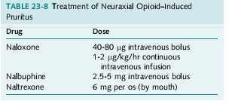
………
Prophylaxis:
Sub-hypnotic doses of propofol (10 to 20 mg),
Ondansetron,
Glucocorticoids
Treatment:
Self-limiting
Naloxone or nalbuphine

Slide 10
Nausea and vomiting
Occur commonly in the peripartum period, with or without neuraxial analgesia
Causes: pregnancy, labor, pain, neuraxial analgesia–induced hypotension, opioid-induced delay of gastric emptying
Incidence: intrathecal opioid analgesia (2.4%) > epidural (1.0%)
Prophylaxis and treatment: ondansetron, metoclopramide, dexamathason, and droperidol

Slide 11
Shivering
Postpartum shivering is a common event, even in the absence of analgesia/anesthesia for labor.
Cause after RA: Sympathetic block–induced vasodilation, with redistribution of body temperature from the core to the periphery.
Results of studies:
No difference in the incidence of shivering between women who chose epidural (bupivacaine/fentanyl) analgesia and those who chose systemic analgesia.
The addition of an opioid to the LA solution may affect the shivering response.
Epidural administration of epinephrine increases shivering; the etiology of this response is unknown.

Slide 12
Urinary retention
A troublesome side effect of labor/delivery and neuraxial anesthesia/analgesia.
Incidence: 14% of women who have a normal spontaneous vaginal delivery without epidural analgesia.
Causes after RA: Both neuraxial local anesthetics and opioids cause urinary retention through suppression of detrusor muscle contractility.
Treatment: catheterization

Slide 13
Complications of Neuraxial Analgesia

Slide 14
Inadequate Analgesia
Results of the failed analgesia after injection of intrathecal or epidural anesthetics:
No neuroblockade
Unilateral blockade
Missed segments
Inadequate density of neuroblockade

Slide 15
…….
Incidence:
The rate of epidural catheter replacement: 5% - 13%.
The rate of failed analgesia: after CSE (10%) << after epidural analgesia (14%).
Factors: Patient age and weight, specific technique, type of epidural catheter, and the skill of the anesthesia provider are associated with the rate of failure of neuraxial analgesia.
Effects on patient: Failure to provide adequate analgesia a dissatisfying experience for the patient and may also lead to litigation.
The risk of failed anesthesia and the potential need to place a second epidural catheter should be discussed with the patient during the preanesthetic evaluation, before placement of the first epidural catheter.

Slide 16
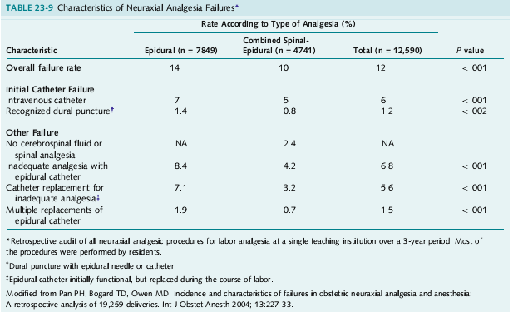
…….

Slide 17
Patient complaints of pain should prompt timely evaluation and treatment

Slide 18
……

Slide 19
……

Slide 20
Respiratory depression
Cause: Neuraxial opioids
Risk factors: Choice and dose of drug, and its interaction with systemically opioids and other CNS depressants
The lipid solubility of the drug (within 2 hours of the injection of a lipid-soluble opioid such as fentanyl or sufentanil) (With a hydrophilic drug such as morphine, the onset of respiratory depression is delayed; 6-12h)
Dose of opioid is a major determinant of the risk of respiratory depression-increase in ETCO2 concentration with intrathecal fentanyl doses of ≥15 µg or higher- sufentanil doses of > 10 µg -30 min after intrathecal injection).
Refrain from administering a bolus dose of epidural or spinal opioid to women who have recently received systemic opioid analgesia.
Treatment: Naloxone

Slide 21
Unintentional Dural Puncture
The rate of unintentional dural puncture with an epidural needle or catheter: 1.5%.
Detection of dural puncture: at the time of insertion of the epidural needle or after placement of the catheter.
Management:
Remove the needle and place an epidural catheter at another interspace; if CSE analgesia was planned, the intrathecal dose may be injected through the epidural needle before it is removed and recited at a different interspace.
Place a catheter in the subarachnoid space and administer continuous spinal analgesia for labor and delivery. (Advantageous for patients at high risk for repeat dural puncture or in cases in which it may be difficult to enter either the epidural or subarachnoid space successfully at an alternative interspace (e.g., in obese women or in patients with abnormal anatomy of the lumbar spine).

Slide 22
Intravascular Injection of local Anesthetic
A serious potential complication during the administration of epidural anesthesia in obstetric patients.
Incidence:1/5000 injection (0.014-0.029)( not used bupivacaine 0.75% in obstetric patients and replaced with ropivacaine and levobupivacaine)
CNS symptoms (e.g., restlessness, dizziness, tinnitus, perioral paresthesia, difficulty speaking, seizures, loss of consciousness), and Cardiovascular effects may progress from increased BP(as a result of sympathetic stimulation) to bradycardia, depressed ventricular function, and VT and VF. Bupivacaine cardiotoxicity may be fatal in pregnant women.

Slide 24
…….

Slide 25
High Neuroblockade or Total Spinal Anesthesia
Incidence:1/16,200 -0.006 (0.003-0.012).
Causes:
After the unintentional and unrecognized placement of the epidural catheter in either the subarachnoid or subdural space and injection of an epidural dose of LA through that catheter
The epidural catheter may migrate into the subarachnoid or subdural space during the course of labor and delivery.
High spinal blockade may result from an overdose of LA in the epidural space.
Symptoms: Agitation, profound hypotension, dyspnea, the inability to speak, and loss of consciousness (from hypoperfusion of the brain and brainstem, not from brain anesthesia).
Prevention: Aspiration + test dose
The omission of the epidural test dose requires that the therapeutic dose of local anesthetic be injecte
slowly, incrementally, and cautiously.

Slide 26
Extensive Motor Blockade
Causes:
Repeated bolus doses of LA
Many hours of a continuous infusion of LA
Administration of bupivacaine with epinephrine
Effects: bothersome for the patient, impair maternal expulsive efforts during the second stage of labor and increase the likelihood of instrumental vaginal delivery
Management: discontinue the infusion for a short period (e.g., 30 minutes). Subsequently, restart the infusion at a reduced rate or with a more dilute solution of local anesthetic.
Extensive motor blockade does not occur with administration of a very dilute solution of local anesthetic combined with an opioid.

Slide 27
Prolonged neuroblockade and neurologic complications
Prolonged Neuroblockade:
Incidence: Rarely
Cause: Epidural administration of a high concentration of LA with epinephrine
Neurologic complications:
Effects: Peripheral nerve injury or an epidural hematoma (symptoms: the absence of back pain, a unilateral block, and regression (rather than progression) of the symptoms)
Management: Neurologic or neurosurgical consultation and immediate imaging studies

Slide 28
Back pain
Incidence: 50% during pregnancy and the puerperium.
Risk factors: Antepartum back pain and inability to reduce weight to pre-pregnancy levels
Results of studies:
No difference in incidence of postpartum back pain among women who delivered with or without epidural analgesia.
No difference in incidence of postpartum back pain among women who delivered with epidural a or systemic analgesia.
No difference in the incidence of backache at 3 and 12 months, and several years after delivery among women who delivered with or without epidural analgesia.
In summary, no causal relationship exists between epidural analgesia and the development of long-term postpartum backache. Short-term backache (several days) may be related to local tissue trauma at the site of skin puncture.

Slide 29
Systemic opioids in labor
Advantages:
Easy administration
Inexpensive
No needles
Avoids complications of regional block
Does not require skilled personnel
Few serious maternal complications

Slide 30
Disadvantages:
All drugs easily cross placenta
Pain relief inadequate in most cases
Maternal sedation
Nausea, vomiting, gastric stasis
Fetal heart rate effects:
loss of beat-to-beat variability
Sinusoidal rhythm
Dose-related maternal / neonatal depression
Newborn neurobehavioral depression

Slide 31
Side effects or problems with remifentanil PCA
Unlike an epidural, remifentanil will not provide total pain relief. A recent study found that 20% of women needed to go on to have an epidural.
Patient will not be able to sleep as you have to stay awake to press the button.
Common side effects can include feeling sick, itching, drowsiness and dizziness, slow breathing which may cause lowered blood Oxygen levels. These effects wear off very quickly when patient stop using it.

Slide 32
Is There Still Place For painful labor?

Slide 34
Conclusion
“The delivery of the infant into the arms of a conscious and pain-free mother is one of the most exciting and rewarding moments in medicine.”

Slide 36
موفق باشید
دکتر خوئی

